Slide 1
Digital Portfolio
STUDENT NAME : Saifali I
REG NO & NMID : 31924U18024
EMAIL : saifumass46@gmail.com
DEPARTMENT : B.Sc. COMPUTER SCIENCE
COLLEGE : MU College Autonomous/
Thiruvalluvar university

Slide 2
PROJECT TITLE
About
Education
Certificates
Hobbies
Details
Projects
Contact

Slide 3
AGEDA
Problem Statement
Project Overview
End Users
Tools and Technologies
Portfolio design and Layout
Features and Functionality
Results and Screenshots
Conclusion
Github Link

Slide 4
PROBLEM STATEMENT
Points:
Difficult to showcase skills effectively without structured layout guidance.
Lack of visual consistency reduces portfolio’s overall professional impact.
Limited technical knowledge hinders building interactive and dynamic sections.
Absence of organized navigation confuses viewers and weakens impression.

Slide 5
PROJECT OVERVIEW
The Portfolio project aims to design and develop a professional platform that highlights personal achievements, skills, and experiences. It provides a structured layout with visually appealing design, ensuring better engagement and clarity for viewers.
Showcases personal skills, achievements, and career development journey.
Provides structured sections for education, projects, and work experience.
Enhances professional identity through attractive and responsive design.
Improves engagement with interactive navigation and user-friendly interface.

Slide 6
WHO ARE THE END USERS?
The portfolio is designed to serve individuals and professionals who want to showcase their personal, academic, or professional achievements in an organized and visually engaging manner.
Key End Users :
Recruiters seeking qualified candidates through professional portfolio presentations.
Employers evaluating applicant skills, projects, and career growth history.
Clients searching for creative individuals to handle professional projects.
Students displaying academic achievements, skills, and extracurricular accomplishments.

Slide 7
TOOLS AND TECHNIQUES
Vs code
Language
(Html / CSS / Java Script)

Slide 8
POTFOLIO DESIGN AND LAYOUT
The portfolio is designed with a professional structure, focusing on clarity, consistency, and user-friendly navigation to highlight skills and achievements effectively.
Key Points :
Clean, minimal design emphasizes professionalism and easy visual flow.
Organized sections highlight projects, skills, education, and personal details.
Responsive layout ensures accessibility across devices and screen sizes.
Consistent colors, fonts, and icons enhance visual identity appeal.

Slide 9
FEATURES AND FUNCTIONALITY
The portfolio includes interactive elements and well-structured features that enhance usability, highlight achievements, and create a professional digital presence.
Key Points :
Interactive navigation enables smooth access to all portfolio sections.
Contact form allows quick communication between visitors and owner.
Project showcase highlights work samples with descriptions and visuals.
Responsive functionality adapts design to multiple devices and screens.

Slide 10
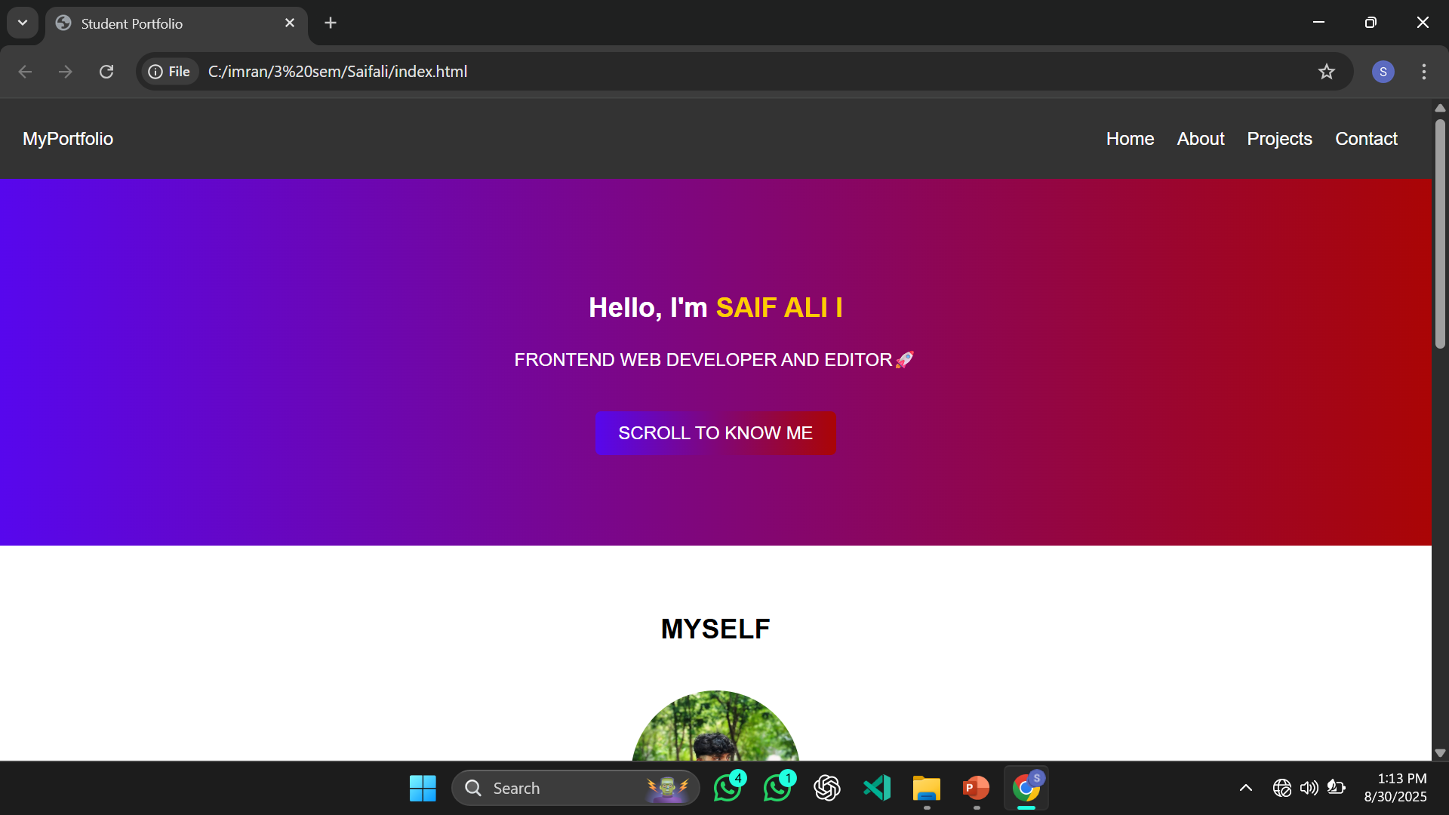
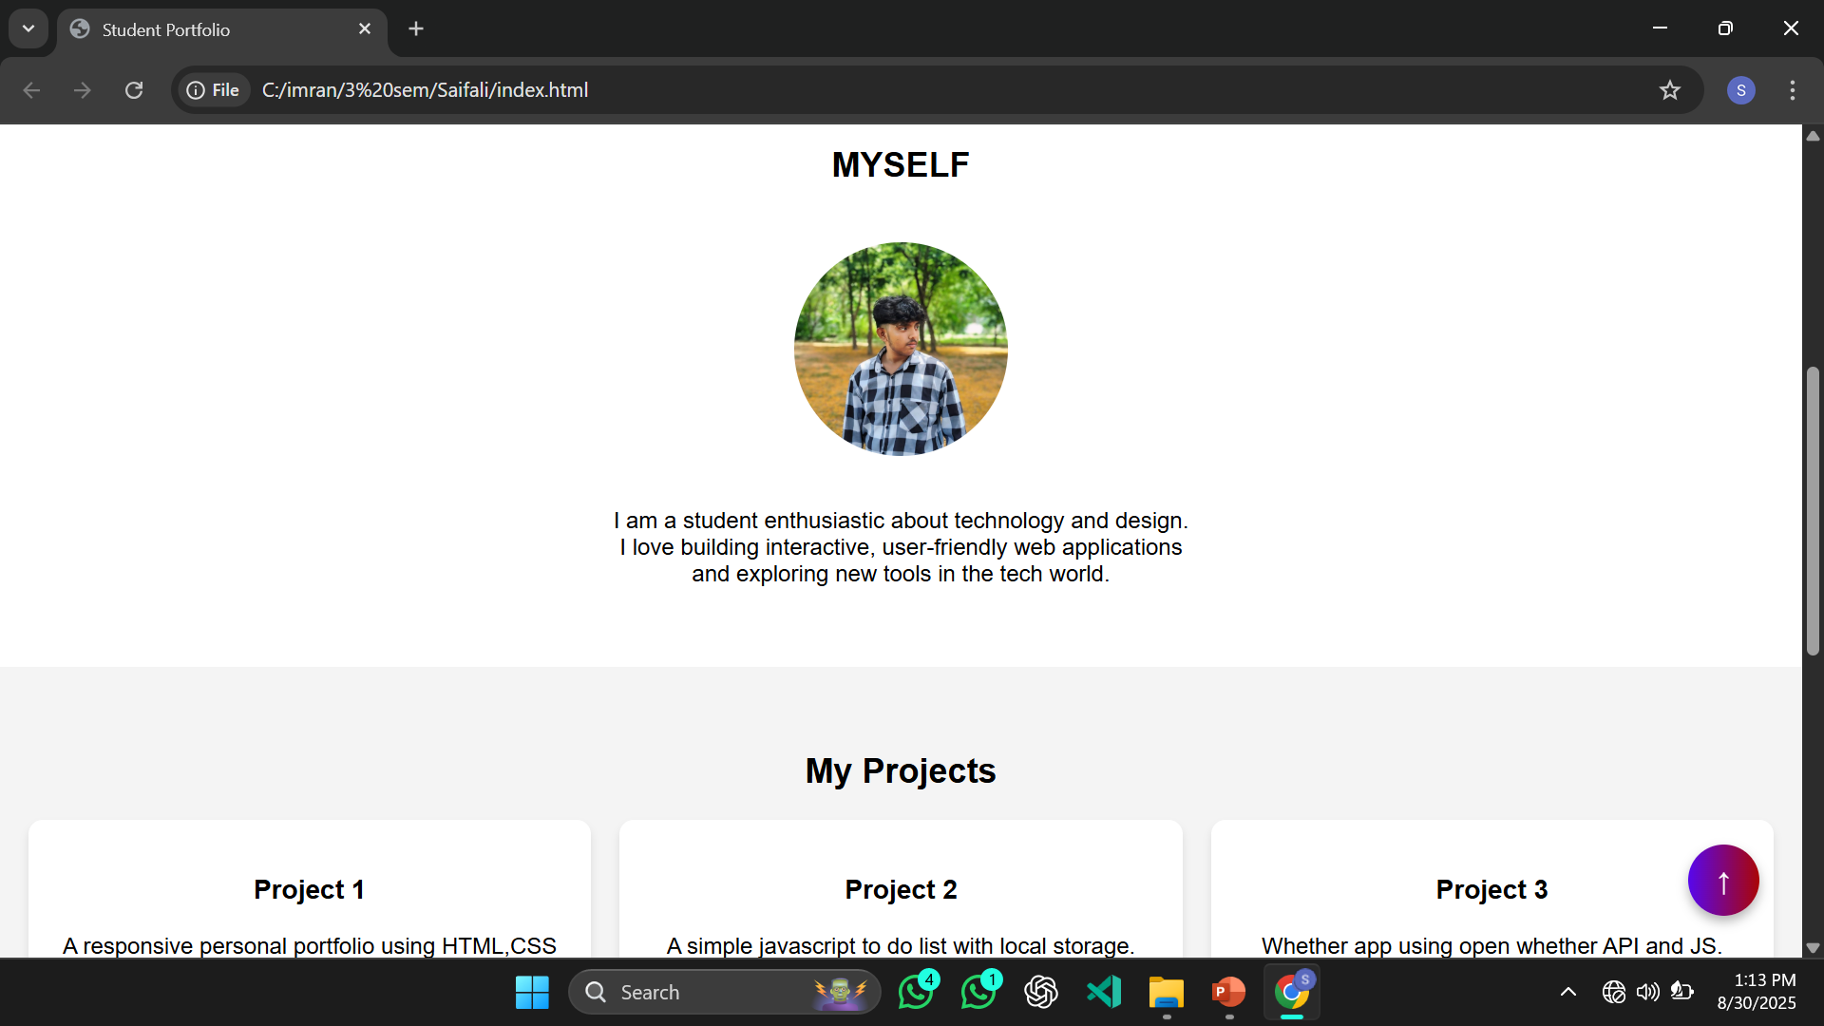
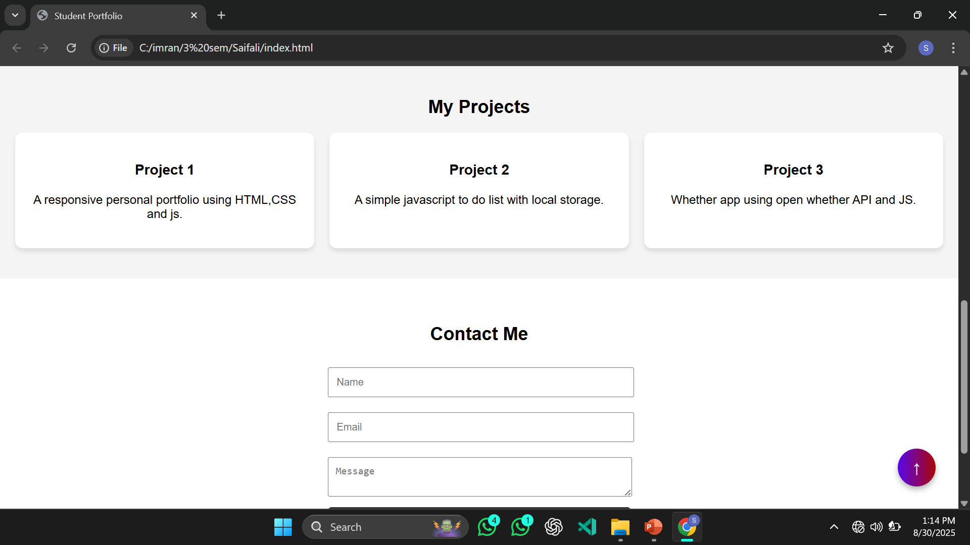
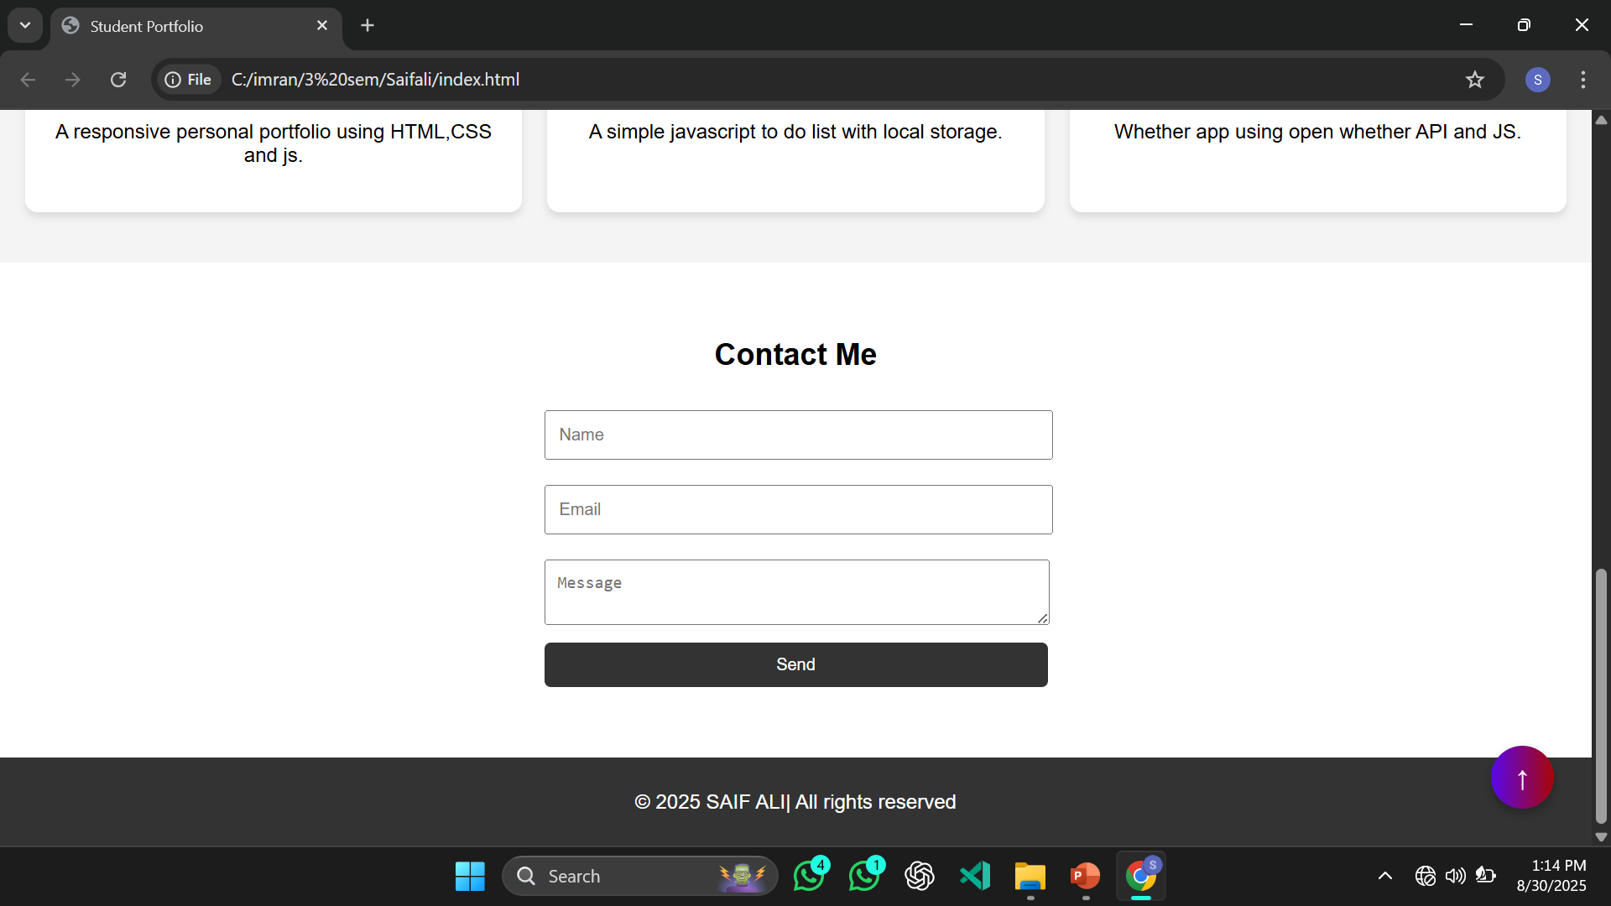
Result and Screenshot
Portfolio effectively showcases skills with responsive design, interactive features, and visually appealing project displays.

Slide 11
CONCLUSION
This portfolio successfully represents personal and professional achievements through a structured, visually appealing, and responsive design. It highlights skills, projects, and experiences in an organized manner, providing easy navigation for users. Serving as a digital identity, it enhances opportunities by creating a lasting impression on employers, recruiters, and clients.

